Slide 1

Lecture 7
Loops

Slide 2

Agenda
Loops
For Loop
For...of Loop
For...in Loop
While Loop
While vs For Loops

Slide 3
Loops

Slide 4

What are Loops?
One of the main purpose of computer is to help doing repetitive tasks for human
Loops = repeating a piece of code multiple times
2 types of loops (almost universal in all programming languages)
  For Loop
  While Loop

Slide 5
When do we need Loops?
Loop through a list of values/objects (e.g. array)
Repeat a task for multiple times (repeat a task for 10 times)
Do something until a certain conditions is met (until time is up, until user finished input, until server side has send me the results etc)
Reduce the number of times we need to copy pasting code

Slide 6
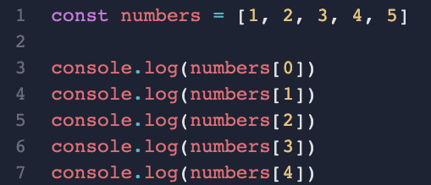
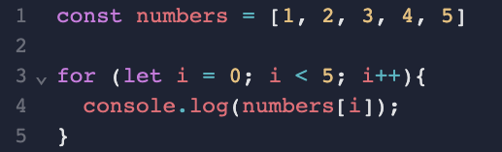
Example
Without Loop
With Loop

Slide 7
For Loop

Slide 8
Types of For Loops
The basic concept: for n times, execute this piece of code
There are three types of for loops
  for - loop through a block of code for certain times
  for/in - loop through the properties of an object
  for/of - loop through the values of an array/list

Slide 9

For
for (initialization; continuing condition; after iteration statement){
// Loop Body - do something
}
enter a loop
initialization
check condition
true
false
After iteration statement
do something

Slide 10
For Loop Example
Continuing Condition
Initialization
After Iteration Statement
for (let i = 0; i < 5; i++){
console.log("value of i: " + i);
}
enter a loop
let i = 0
Loop Body
i < 5
true
false
i++
console.log()

Slide 11
For Loop Variations 1 - For … of Loop

Slide 12
For ... of
for (let element of array){
console.log(element);
}
Note: change the value of element will not affect the original array

Slide 13
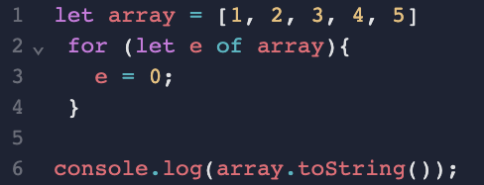
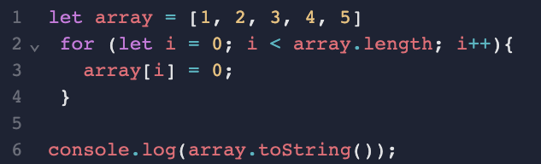


Traps!
Note: change the value of element will not affect the original array

Slide 14
For Loop Variations 2 - For … In Loop

Slide 15
For / in
for (let property in object){
// do something
}

Slide 16
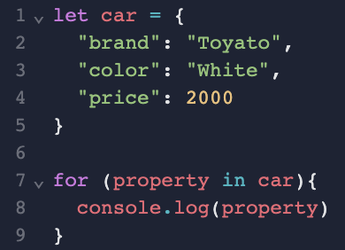
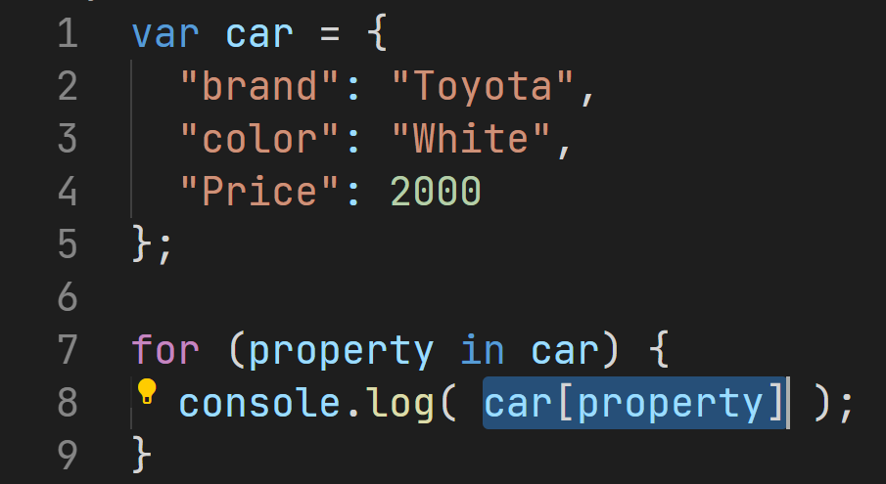
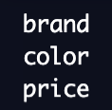

Be careful

Slide 17
While Loop

Slide 18
Types of While Loops
Basic Concept: keep running the piece of code until a condition is met
There are 2 types of while loops
  while loop
  do...while loop

Slide 19
While
enter a loop
while (condition) {
//do something
}
check condition
true
do something
false

Slide 20
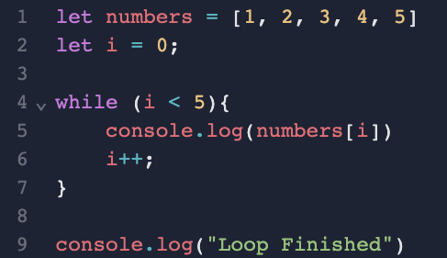
Example

Slide 21
Do While Loop

Slide 22
Do ... While
enter a loop
do {
//do something
} while (condition)
do something
true
check condition
false

Slide 23
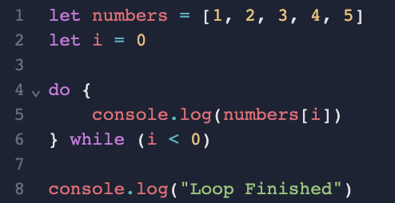
Do...While Loop

Slide 24
While vs For

Slide 25
Example
const numbers = [1, 2, 3, 4, 5]
for (let i = 0; i < 5; i++){
console.log(numbers[i])
}
console.log("Loop Finished")
const numbers = [1, 2, 3, 4, 5]
let i = 0;
while (i < 5){
console.log(numbers[i])
i++;
}
console.log("Loop Finished")

